Slide 1
Digital Explorer Badges
David Stevens

Slide 2
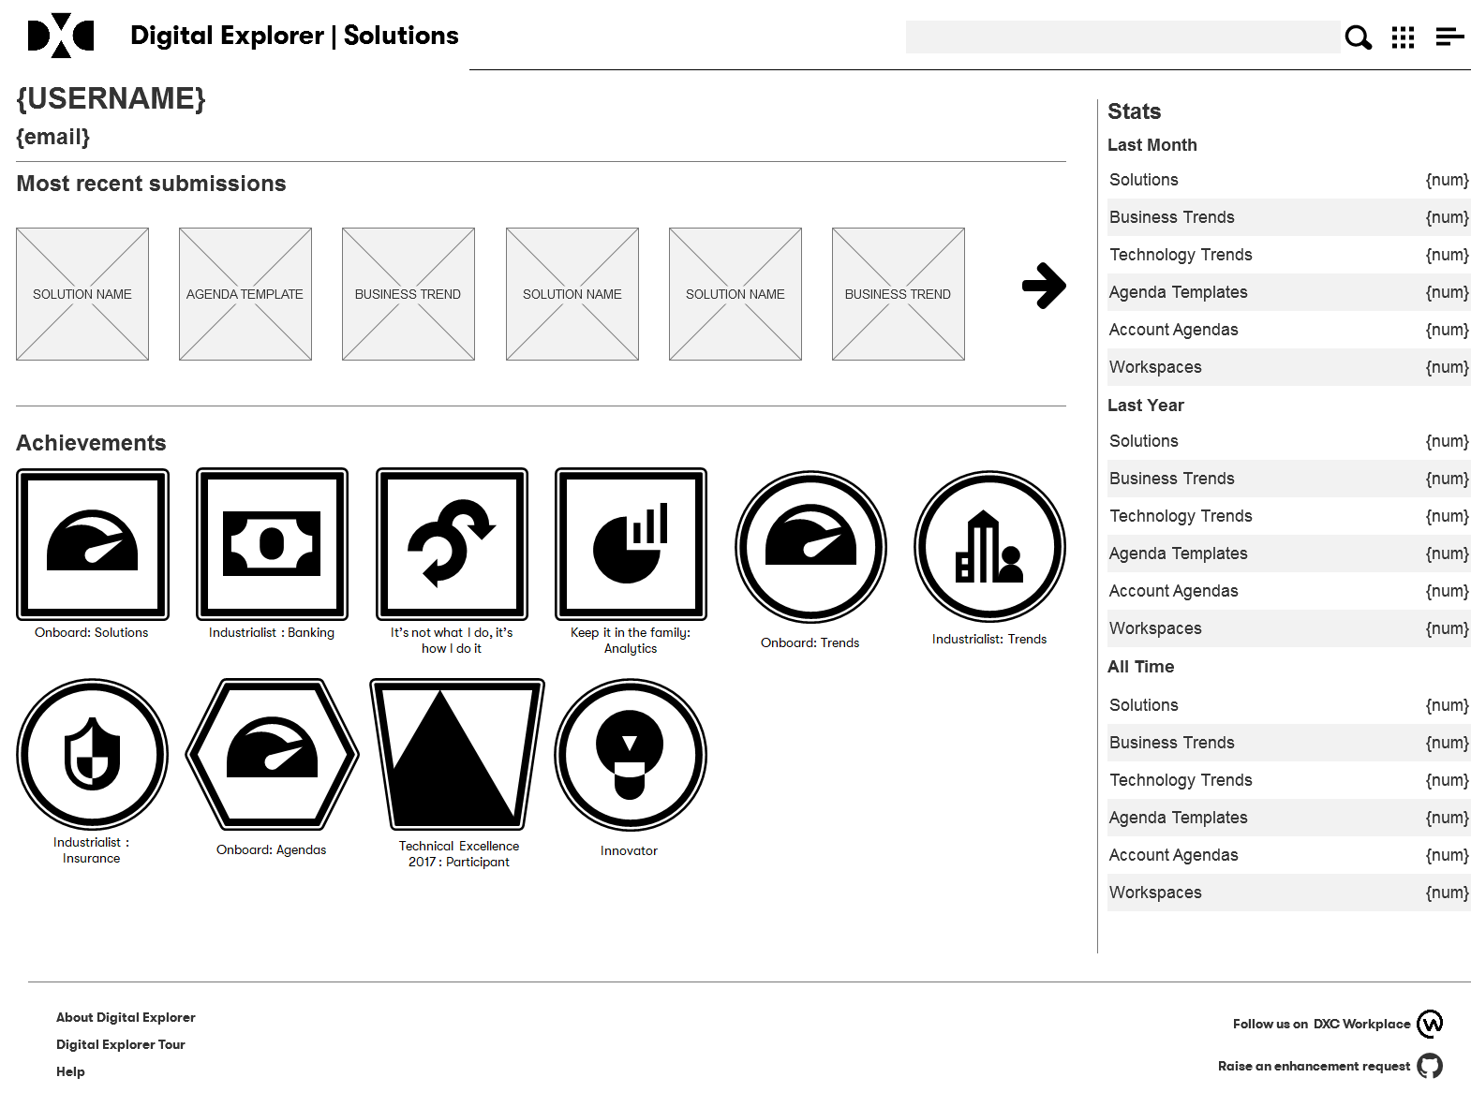
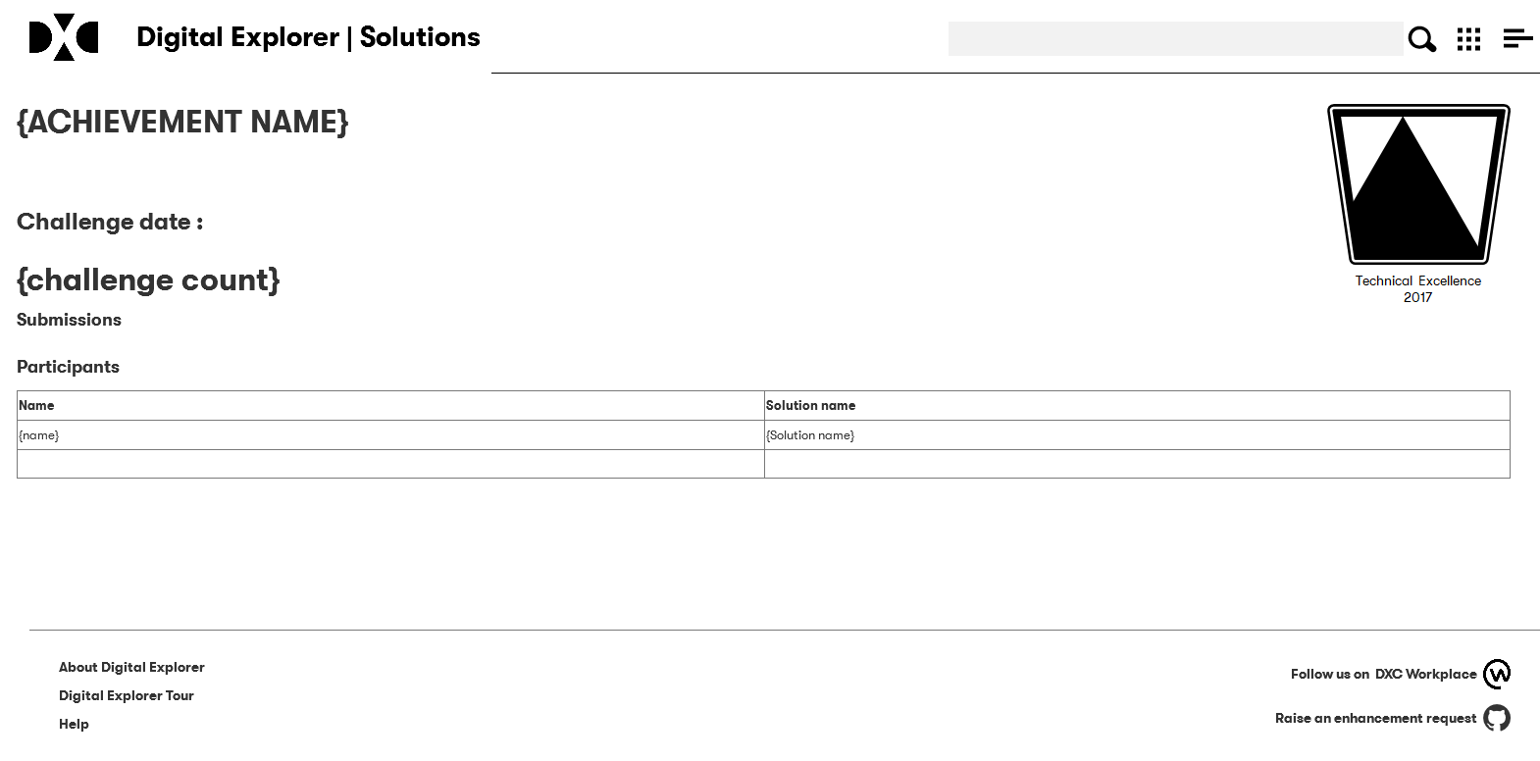
Revised user profile pages and achievement/challenge leader boards

Slide 3
Badge design constraints
Solutions
Trends
Must align to DXC colours
Must leverage or compliment DXC standard icons
Standard image size of 250px x 250px
Workspace
Agendas
Challenges

Slide 4
Digital Explorer Badge : Solutions
Calculated based on the content within the solutions
Name
Onboard | Submit your 1st solution
Journeyman | Submit your 5th solution
Master | Submit your 10th solution
Keep it in the family | Submit your first solution for a named offering family
We are all friends here | Submit your first solution which includes a partner capability
It’s not what I do, it’s how I do it | Submit your first solution which includes a methodology
Onboard: Solutions
Journeyman
Master
We are all friends here
It’s not what I do, it’s how I do it

Slide 5
Keep it in the family
Keep it in the family: Cloud
Keep it in the family: Workplace
Keep it in the family: BPS
Keep it in the family: Analytics
Keep it in the family: Security
Keep it in the family: Industry Solutions
Keep it in the family: Consulting

Slide 6
Industrialist : Solutions
Industrialist : Communications
Industrialist : Insurance
Industrialist : Banking
Industrialist : Manufacturing
Industrialist : Healthcare
Industrialist : Energy
Industrialist : Public Sector
Industrialist : Travel & Transportation
Industrialist : Consumer & Retail

Slide 7

Digital Explorer Badge : Trends
Calculated based on the content within the trends and solution modules
Name
Onboard | Submit your first Trend (add new trend or add new industry use case to existing)
Industrialist | Submit a trend against a named industry
Thought Leader | Submit 10 or more trends
Technologist | Submit a technology Trend
Onboard: Trends
Thought Leader
Technologist

Slide 8
Industrialist : Communications
Industrialist : Insurance
Industrialist : Banking
Industrialist : Manufacturing
Industrialist : Healthcare
Industrialist : Energy
Industrialist : Public Sector
Industrialist : Travel & Transportation
Industrialist : Consumer & Retail

Slide 9
Digital Explorer Badge : Agendas
Calculated based on the content within the agendas module
Name
Onboard | Member of an account team with an innovation agenda
Helping hands | Create your first agenda template
Taking the next step | Member of an account team who have created a strategic initiative
Onboard: Agendas
Helping hands
Taking the next step

Slide 10
Digital Explorer Badge : Workspace
Calculated based on the content within the workspace module
Onboard | Create your first workspace
In the Club | Added as a member of an existing workspace

Slide 11

Digital Explorer Badge : Challenges
Calculated based on the tagged valued against solutions
Name
Participant | Submit a solution for an event
Winner | Member of the winning team
Unique icon for each event – need a designer
Technical Excellence 2017 : Participant
Technical Excellence 2017 : Winner
Technical Excellence 2017

